Slide 1
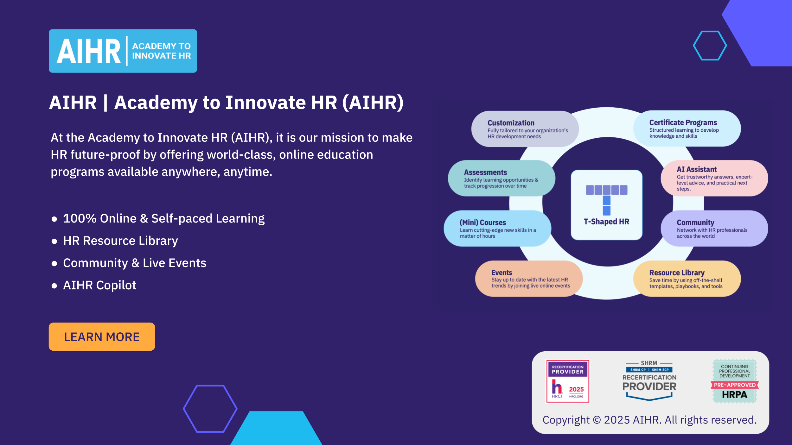

Slide 2

[Organization’s name]
[REPORT NAME]
[Date]
[Logo]

Slide 3
How to use this presentation template
  Start with a high-level overview showing the four SWOT categories - Strengths, Weaknesses, Opportunities, and Threats. This gives your audience a quick snapshot of the focus areas.
                Strengths: List HR’s achievements, and how HR is different from other organizations’ HR departments.
                Weaknesses: Note the areas where HR is currently underperforming, the internal factors that make goal achievement difficult, and what resources HR is lacking.
                Opportunities: List the external resources that can support HR goal achievement, what HR tech will help HR perform more efficiently.
                Threats: State if automation will replace HR staff, how target candidates view the organization, and if other HR teams have an edge over yours.
              Break it down quadrant by quadrant. Dedicate at least one slide to each SWOT category. For each, highlight 2-3 focused points to keep it sharp and actionable. Avoid overwhelming the slide with long lists.
              Add a summary or action slide. After all four areas are presented, you can include a final slide that highlights key takeaways or next steps for the HR team or leadership.

Slide 4
HR SWOT ANALYSIS: AN OVERVIEW
S | W
STRENGTHS | WEAKNESSES
EXAMPLE: List the areas where the company’s HR department excels. Strong employer branding Competitive compensation package Well-developed employee training programs | EXAMPLE: Note the areas where HR is underperforming and needs to improve. Limited resources High employee turnover Inconsistent manager training
O | T
OPPORTUNITIES | THREATS
EXAMPLE: List the external resources/trends that can make HR more efficient. Investment in HR tech Changing current HR policies Flexible and remote work models | EXAMPLE: State if automation poses a threat, and other HR teams have an edge. Tight labor market Automation Data privacy

Slide 5
STRENGTHS
[Insert logo]
Strong employer brand
Competitive compensation package
Well-developed employee training programs
Company has strong, recognizable employer branding
Saves budget on job advertising and hiring a staffing agency
Employees are more motivated and as such, perform better at work.
Boosts employee morale and job satisfaction while reducing turnover
HR ensures solid onboarding, learning, and development systems
Employees can progress more quickly while remaining productive

Slide 6
WEAKNESSES
[Insert logo]
Limited resources
High turnover
Inconsistent manager training
Restricted recruitment budget prolongs the hiring process
Existing team members feel tired and demotivated due to larger workload
Understaffing leads to failure to hit productivity targets
High performers leave to join competitors
Employee engagement and business operations are affected (e.g., postponed business decisions)
Not all team leads get the same support or coaching
This leadership quality gaps, causing a sense of unfairness among managers and their teams

Slide 7
OPPORTUNITIES
[Insert logo]
Investment in HR tech
Changing current HR policies
Flexible and remote work models
Automation of repetitive tasks (candidate screening, onboarding, payroll, employee records) can streamline HR operations
HR can use VR to train employees to use new equipment, or give remote candidates an office tour
Changing current HR policies to reflect the ‘new normal’ of work keeps the company up-to-date
Boosts job satisfaction and employee productivity
Offering hybrid and remote roles can help attract and retain top talent
Post-COVID, more employees value the work-life balance remote/hybrid work offers

Slide 8
THREATS
[Insert logo]
Tight labor market
Automation
Data privacy
Talent shortage could result in about significant unrealized annual revenues
Better C&B packages can mitigate the risk of losing staff to competitors that offer better pay or work conditions
There are concerns that automation may make HR redundant
This may create resistance to adopting new technology, and affect employee morale
HR must reassure staff that their personal data (i.e., social security number, bank information) is secure
Otherwise, the company will face the consequences of failing to protect employee details (e.g., penalties, lawsuits, tarnished reputation)

Slide 9
KEY TAKEAWAYS & NEXT STEPS
Key takeaways | Next steps
STRENGTHS
… | …
WEAKNESSES | T
… | …
[Insert logo]

Slide 10
KEY TAKEAWAYS & NEXT STEPS
Key takeaways | Next steps
OPPORTUNITIES
… | …
THREATS | T
… | …
[Insert logo]

