Slide 1
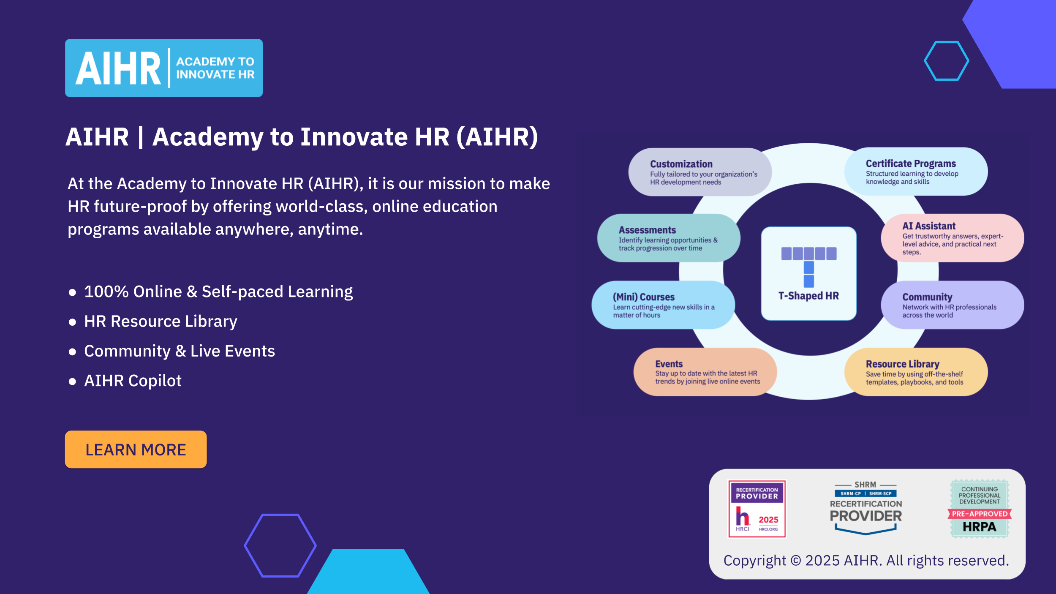

Slide 2
How to use this presentation template
  This template is built to help you present the results of your HR audit in a clear, structured, and business-aligned way. To tailor it to your needs:
  Follow the examples on each slide as a guide. Update them with your own findings, data, and recommendations.
  Replace all placeholders (e.g., “[Description]”) with your organization’s content.
  Reorder, remove, or duplicate slides depending on what’s most relevant to your audience. The flow is flexible.
  Keep it concise — aim for simple, executive-ready messaging.
  Add visuals like charts and icons where relevant to make complex findings easier to digest.
  Consider ending each major section with a one-slide summary of top findings, risks, or actions. This helps executives stay focused.

Slide 3
[Organization’s name]
[HR AUDIT REPORT NAME]
[Date]
[Logo]

Slide 4
EXECUTIVE SUMMARY

Slide 5

Executive Summary
[Insert logo]
This HR Audit Report summarizes the findings of a comprehensive review of Human Resources policies, procedures, and systems at [Organization Name].
The audit aimed to identify areas of strength, compliance gaps, and opportunities for process improvement and efficiency enhancement.
Key findings | Critical recommendations
Compliance risk: Significant non-compliance with recent California labor laws, particularly concerning wage and hour regulations and leave policies; this poses high legal and financial risk. | Immediate compliance review: Engage labor counsel to update all HR policies, and the employee handbook to ensure full California labor law compliance.

Slide 6
AUDIT SCOPE & OBJECTIVES

Slide 7
Audit Scope & Objectives
[Insert logo]
Purpose
The purpose of this HR audit was to conduct a systematic review of [Organization Name]'s HR policies, procedures, documentation, and systems to assess their effectiveness, compliance, and alignment with organizational goals.
Scope
The audit covered the following key HR functions and areas:
  Recruitment and onboarding
  Compensation and benefits
  HR compliance (with a specific focus on California state and federal labor laws)
  Employee relations
  Performance management.
Time period covered
  The audit was conducted over a three-month period (April 1 2025, to June 30 2025).
  The data, policies, and practices reviewed covered the preceding 12 months, from April 1 2024, to March 31 2025.

Slide 8
Audit Scope & Objectives
[Insert logo]
Overarching objectives
Risk identification
Identify potential legal, financial, or operational risks associated with current HR practices, particularly in relation to California labor laws.
Process improvement
Pinpoint inefficiencies and areas for enhancement within HR processes to improve effectiveness and employee experience.
Objective 3

Slide 9
METHODOLOGY

Slide 10
Methodology
[Insert logo]
The audit adopted the following multi-faceted approach to ensure comprehensive data collection and analysis:
Data collection:
Document review: [Description]
Data analysis: [Description]
Employee surveys: [Description]
Interviews: [Description]
Tools used:
[Tool 1]
[Tool 2]
[Tool 3]
Data analysis:
[Briefly describe process]

Slide 11
SUMMARY OF FINDINGS

Slide 12
Recruitment & Onboarding
[Insert logo]
Finding | Evidence
The onboarding process is largely manual, inconsistent across departments, and lacks a structured 30-60-90 day follow-up plan for new hires. | New hire survey feedback indicated a lack of clarity on roles and expectations (30% of new hires reported this). HRIS data showed a 35% drop-off rate for new hires within the first 90 days, significantly higher than the industry average of 20%. New hire checklists were found to be inconsistently applied.
[Finding 2] | [Evidence 2]

Slide 13
Area 2
[Insert logo]
Finding | Evidence
[Finding 1] | [Evidence 1]
[Finding 2] | [Evidence 2]

Slide 14
RISK ASSESSMENT

Slide 15
Risk Assessment
[Insert logo]
Risk Area | Nature | Potential Impact | Severity
Non-compliance with California Wage & Hour Laws & outdated leave policies | Legal non-compliance with state-specific regulations (overtime, meal/rest breaks, paid sick leave, harassment training). | Significant financial penalties, class-action lawsuits, reputational damage, back pay liabilities, and increased scrutiny from regulatory bodies. | High
[Risk 2] | [Risk description] | [Potential impact description] | [Severity assessment]
 |  |  | Medium
 |  |  | Low-Medium

Slide 16
STRENGTHS & OPPORTUNITIES

Slide 17
Strengths
[Insert logo]
Effective internal communication
[Organization Name] maintains strong internal communication channels for company-wide announcements and operational updates, ensuring employees are generally well-informed about business developments.
[Description]
Strength 2
[Description]
Strength 3

Slide 18
Opportunities
[Insert logo]
Leverage communication channels
Utilize existing effective internal communication channels to disseminate HR policy updates, training opportunities, and employee recognition programs more broadly.
[Description]
[Opportunity 2]
[Description]
[Opportunity 3]

Slide 19
ACTION PLAN

Slide 20
Action Plan
[Insert logo]
Action Item 1: HR Compliance Review and Update
Initiative | Responsibility | Resources | Timeline | KPIs for Success
Engage external labor counsel to conduct a comprehensive review of all HR policies, procedures, and the employee handbook Update all non-compliant policies to align with current California and federal labor laws (e.g., SB 616, wage and hour regulations, harassment prevention training). | HR Director (Lead) Legal Counsel HR Generalists | Dedicated legal budget (estimated at $15,000) HR team time for policy drafting and review. | Q3 2025 (completion by September 30 2025) | 100% of identified non-compliant policies updated and approved by legal counsel New employee handbook published and distributed to all employees Zero compliance-related penalties or lawsuits in the next 12 months.

Slide 21
Action Plan
[Insert logo]
Action Item 2
Initiative | Responsibility | Resources | Timeline | KPIs for Success

Slide 22
PROGRESS TRACKING & REVIEW

Slide 23
Progress Tracking & Review
[Insert logo]
Progress on these three action items will be reviewed bi-weekly by the HR leadership team, and reported quarterly to the Executive Leadership Team.
The HR Director, as designated project manager, will oversee the implementation of these action items and track KPIs.
A follow-up HR audit will be scheduled for July 2026 to assess the impact of these changes.

Slide 24
APPENDICES

Slide 25
Appendices
[Insert logo]
This section contains the following supporting documentation:
Detailed employee survey results and verbatim comments
Raw HRIS data tables (e.g., turnover rates by department, time to hire by role)
Interview transcripts (anonymized)
Specific California Labor Code references for compliance issues
Cost-benefit analysis for HRIS implementation.

